Slide 1




SPAM CALL RECOGNITION
With ever growing adaptation of cellphones as the primary medium of communication, the persistent issue of dealing spam calls has been growing significantly
In 2019, there was an 18% (Appendix :[24]) increase in spam calls around the globe as compared to the previous year, as reported by a Stockholm based firm ‘Truecaller’
In this project, we tried to use latest speech recognition technologies and machine learning algorithms to detect and classify a call as spam or not
Receive Call Recordings
Transcribe using Google Speech Recognition Tool
Preprocess text data and apply ML algorithms
Predict : Spam(1) or not (0)

Slide 2
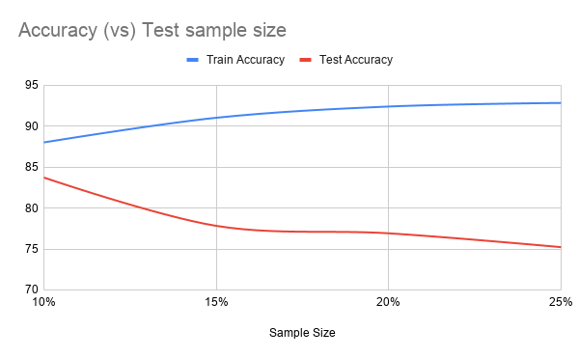
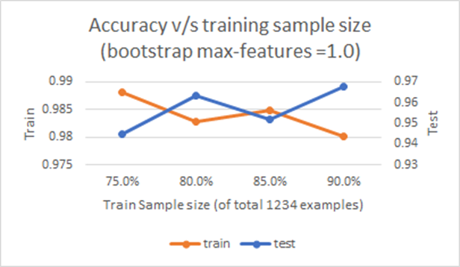
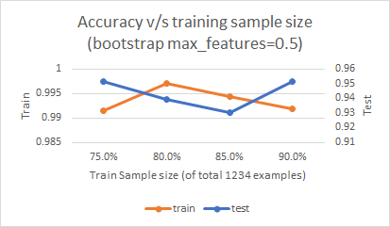
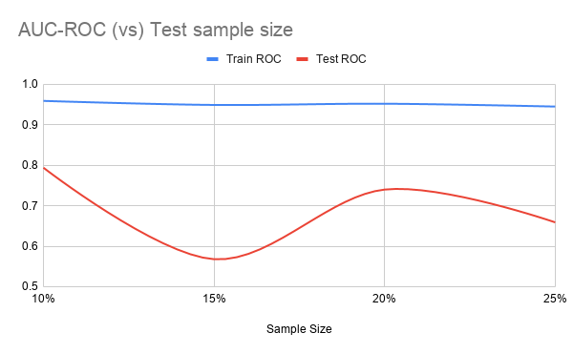
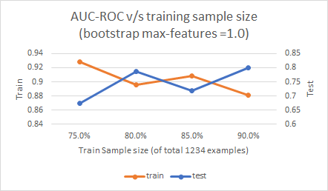
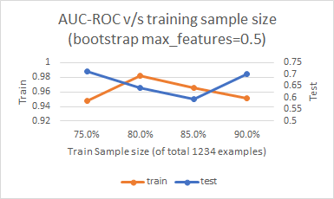
SPAM CALL RECOGNITION
Gaussian Naïve Bayes Classifier – Own Implementation
Sklearn Decision Tree Classifier
Sklearn Support Vector Machine Classifier

